Slide 1
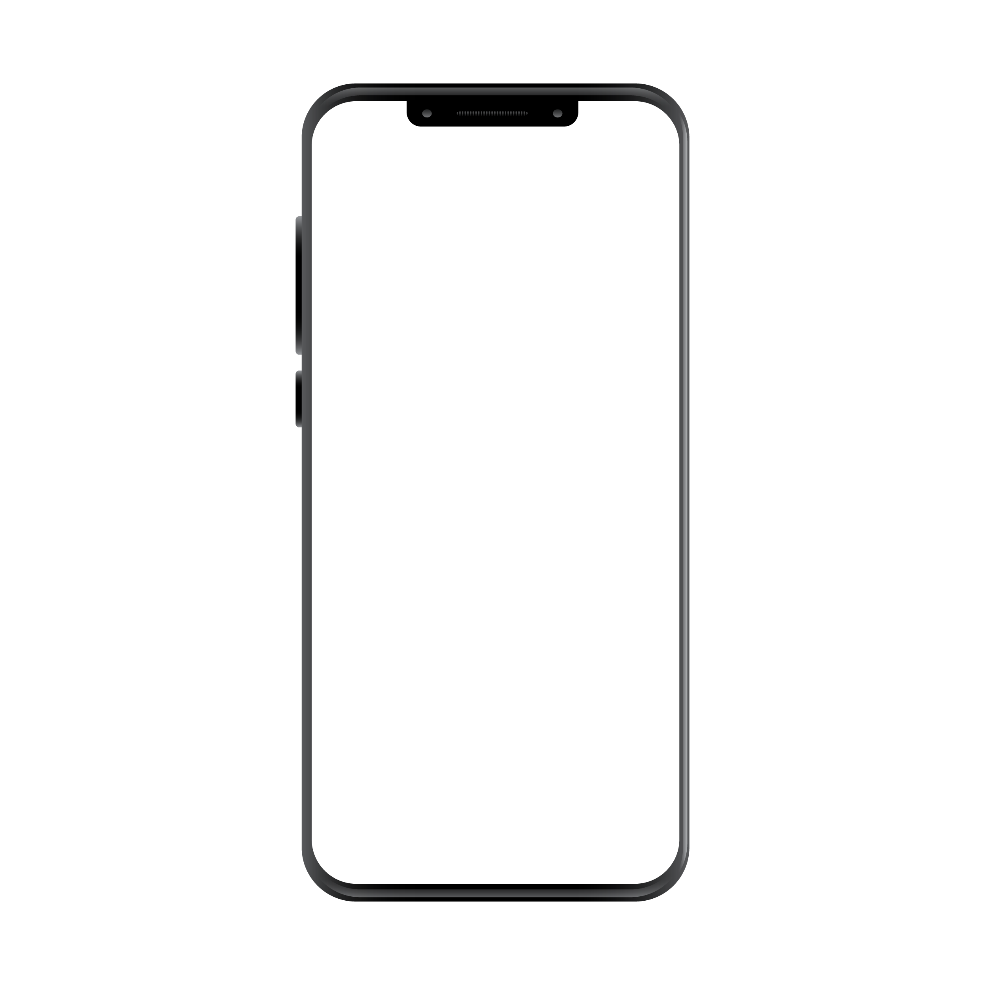
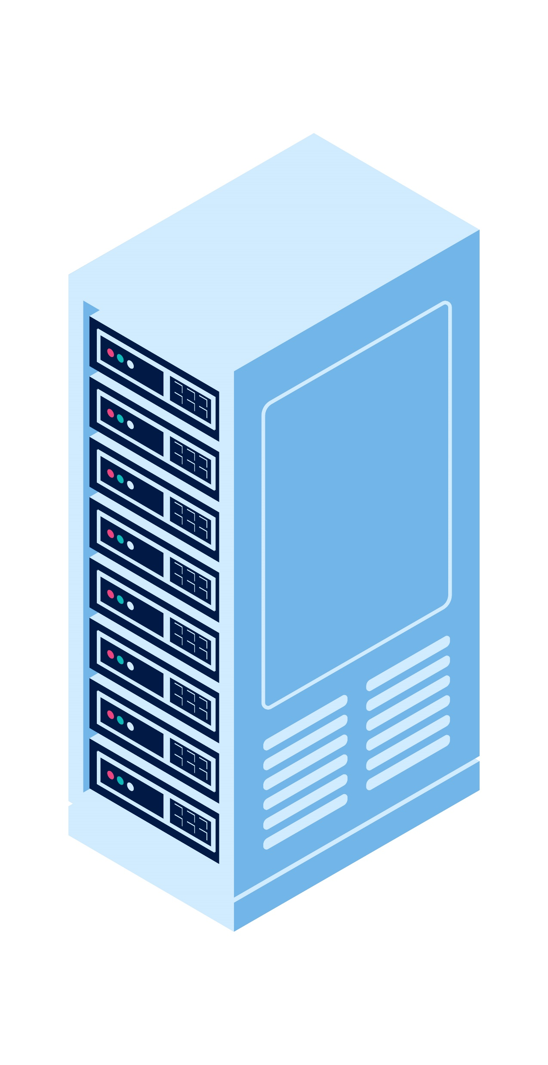



Application
입력
REST API
Server
출력
User

Slide 2




Application
AI(LLM)
입력
REST API
Server
출력
User
DB
AI(VLM)

